Slide 1
Collabera Overview

Slide 2


A Global IT and Professional Staffing & Services Firm
Established in 1991, headquartered in New Jersey
$600 million in revenue with ~ 14,000+ employees
60 offices across 12 countries
3 Proximity Delivery Centers in the US

Slide 3

Global Footprint
Canada Brampton Toronto Vancouver
United Kingdom
London
Poland
3 Proximity Development Centers in US Basking Ridge, NJ | Irving, TX | Charlotte, NC
Romania
Ireland
Netherlands
Tempe, AZ
Scottsdale, AZ
Irvine, CA
Newport Beach, CA
Manhattan Beach, CA
San Diego, CA
San Francisco, CA
San Jose, CA
San Ramon, CA
Greenwood Village, CO
Orlando, FL
Tampa, FL
Atlanta, GA
Des Moines, IA
Meridian, ID
Chicago, IL (2)
Des Plaines, IL
Boston, MA
Southfield, MI
Minneapolis, MN
Clayton, MO
Hoboken, NJ
Charlotte, NC
Durham, NC
Worthington, OH
Independence, OH
Portland, OR
New Hope, PA
Nashville, TN
Austin, TX
Houston, TX
Plano, TX
Herndon, VA
Glen Allen, VA
Redmond, WA
Seattle, WA
Milwaukee, WI
United States
Philippines
- Makati City
- Cebu City
India - Bangalore - Baroda - Mumbai - Hyderabad - Gurgaon - Kolkata
Malaysia
Kuala Lumpur
Penang
Singapore
Australia
Sydney
Melbourne
5 Proximity Development Centers in India
Bangalore | Baroda | Pune | Manila | Kuala Lumpur

Slide 4


Performance
Ranked the “Best Staffing Firm to Work For” 7 years in a row by SIA
Ranked among the Top 10 IT Staffing firms in the US
Recognized as the largest minority-owned IT Staffing firm in the US
Top 3 Preferred Partner to 90% of our Enterprise Clients

Slide 5


Critical Success Factors
Client-centric business model
High touch employee care model
Competency-driven and client focused recruiting
Proprietary systems and metrics driven dashboards

Slide 6
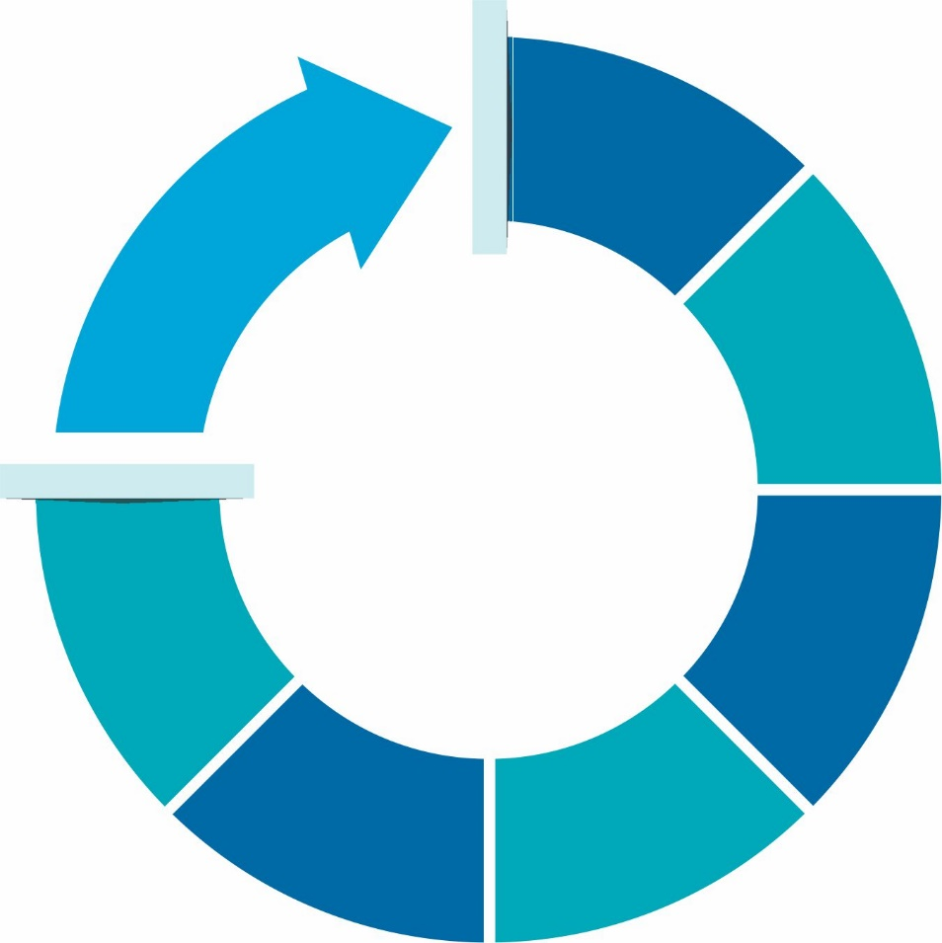
Our Services
Staff
Augmentation
Direct
Hire
From pure play
T&M based engagements to
managed services,
we are one-stop
solution providers for
all your project needs
Onsite-
Offshore
Hybrid
Hiring
Managed
Services
Training Services/
Hire, Train
and Deploy
Program
Landed
Resources

Slide 7

Overview – Australia Operations
Fully operational entity with offices in Sydney and Melbourne respectively.
Region – centric engagement and delivery model with recruiting and operations team based out of Sydney and Melbourne
Ability to provide support across all major locations in Australia
24/7 recruiting support using the onsite/offshore model
Servicing client on both IT & Functional needs from a staffing and a recruitment perspective.

Slide 8

Client-centric business model driving performance
Dedicated teams trained
to meet your individual needs
Teams crafted specifically for each client, using Collabera’s unique Account Mapping Process (CAMP)
Continuous investments in people, systems, tools and processes specific to your line of business
Stringent 4 stage candidate qualification process

Slide 9

Overview – APAC Operations
Strong presence in APAC region with Operations in India, Singapore, Malaysia and Philippines
Regional approach across all the 4 regions with operations spread across the entire region.
Client centric approach with dedicated account team for all clients across all the regions; based on best practices from U.S. operations.
Over 6000 Collabera consultants working at client locations across APAC
Staffing based, on-site & offshore and project based engagement models.
TACT initiative to provide competency based training to consultants for Train & Deploy services
Providing managed offshore services and project based services to strategic clients.
Serving more than 300 clients within APAC; Partner of choice for Fortune 500 firms for their staffing / resourcing and recruitment needs.
Global Technology giants, BFSI Institutions, Pharma and Healthcare companies, Automotive & Engineering service providers are some of the sectors where we have build strong partnerships

Slide 10

The Recruiting Differentiator — TCU
Focus on Emerging technologies and commonly consumed skills
Big Data & Analytics, Cloud, Mobility, Java/.Net, PM, SAP
Improved placement
ratio ~ 45% as compared to traditional staffing
Reduces time to place resources by 48 hours or more
Hire-Train-Deploy model: Our workforce up-skilled by in-house trainers. (Java developer trained on Hadoop)
Recruiters who talk the same language as the experts
Deep pipeline of qualified candidates by skill and by region
Recruiters with industry experience and certifications, not generalists
Rapid response to resource requests
Post placement workshops and networking, with SME support
Sponsorship support for industry certifications
3,000,000
14,000+
Active profiles, globally
Assignments in 2017

Slide 11

Employee Care and Retention
Recognized as “The Best Staffing Firm to Work For” — by SIA — 6 years in a row
High Touch Model
CARES – issue resolution and escalation process (consultants and client)
Single POC
Smooth on-boarding
Timely issue resolution
Expectation management
1 ER for every 75-100 employees
100 + Employee Care Specialists
Personal and
Career Development
Reward and recognition
Training
Mentoring
Relocation and Financial assistance
Multi-option Benefits program
Effective
Re-Deployment Model
Over 35% redeployment across clients
< 10 days wait
15-day roll-off lists
Rewards & Recognitions
Star-performer awards | Spot awards
Referral bonuses & raffles | Project-end bonuses

Slide 12

Unique Talent Acquisition Model
Requirement to submissions ratio
> 95%
Interview ratio
> 33%
Hire ratio > 24%
75% resource contract renewals
Low attrition
~ 9%
100% compliance on client SLAs
24x7 recruiting
Team of over 600 recruiters
Strong focus on retention and performance of employees
with 100+ employee care specialists
Skill-based recruiting driven by Technology Competency Recruiting Units

Slide 13
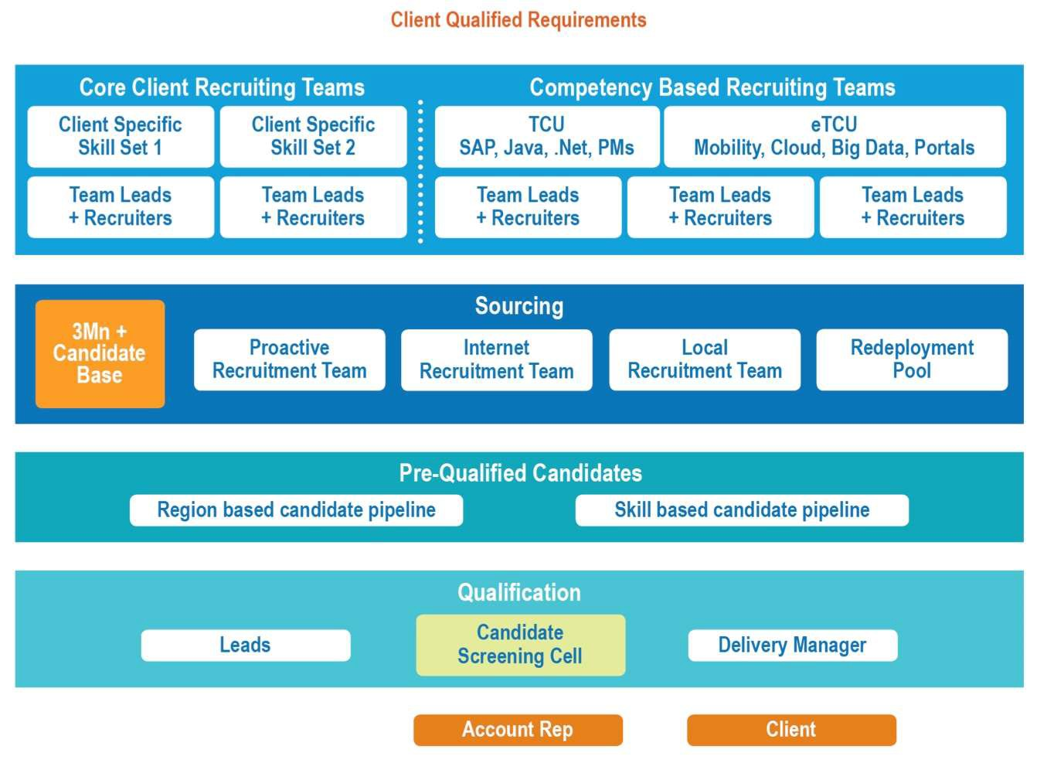
Tower Based Competency Recruiting Model
Cost
Collabera average rates approx. 10% lower than peer suppliers
Quality
Collabera’s Select % is 20% higher than Industry
Speed
Collabera’s average Speed
is best among peer suppliers
Coverage
Collabera Response % is highest among peer suppliers

Slide 14
Direct Hire Placement
Hundreds of professionals placed globally with some of the world’s biggest companies
Highly experienced team of Direct Hire Recruiters act as extensions of our client teams
Recruiters with 5+ years of experience in the industry on average
Extensive database of candidates, networks and contacts
Leverage Technology Competency Units for niche and hard-to-find skill sets
IT competency
ETL, BI/DW,
Mainframe, Java/.Net, QA/Testing, Emerging Technologies (mobile, cloud, big data, social, portal), Architects
PM competency Project Managers, Iteration Managers, Agile, Scrum Masters, Business Analysts, Project Coordinators
~ 92%
offer to hire rate

Slide 15
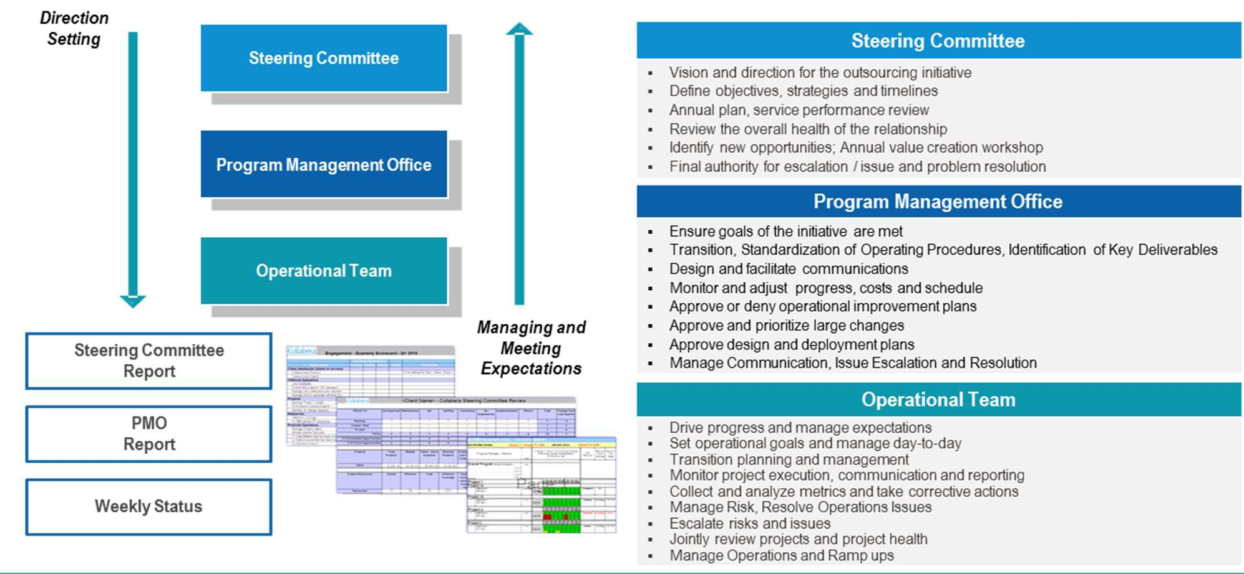
Stringent Governance & Service Quality

Slide 16



Why Collabera?
Proven Global Industry Leader
27 years experience in the IT and Professional Staffing & Services space
Strong Fundamentals
Financially strong and a client-centric culture
Successful Track Record
Dedicated and performance-driven client engagement teams focused on becoming one of the top 3 vendors
Recruiting
Competency-based model for better quality and 24/7 recruiting operations for better responsiveness
Value beyond Staffing
Technology Competency Units (TCUs) & managed services offerings for high performance synergistic teams providing better governance, ownership and quality
Retention
High touch employee care model and HR strategies resulting in above industry retention levels and awards

Slide 17
“
THANK
YOU
“

